Slide 1

Scripting Languages
Module 3
Working with Data in bash

Slide 2
Contents
Acquiring User Input
Conditional Testing
Using Arrays
Doing Basic Maths in bash
Code Commenting
Resources

Slide 3
Learning Objectives
By the end of this Module you will :
Be familiar with various methods of acquiring user input for script execution
Know how to apply a range of conditional testing techniques to build decision-making capability into your scripts
Know how to store set of data in, and work with arrays
Know how to perform basic mathematical operations in bash
Understand the importance of code commenting and how to place comments into your code

Slide 4


Acquiring User Input

Slide 5
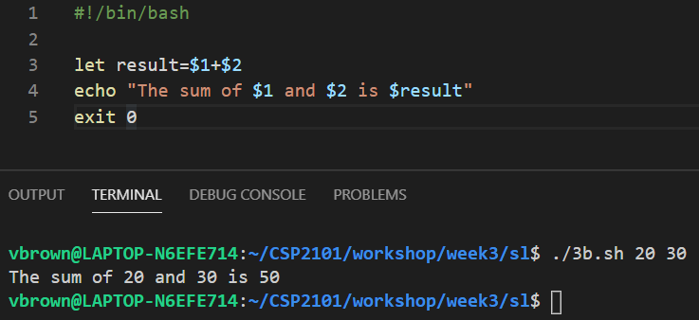
User Input Using Command Line Arguments
Command-line arguments like $1, $2, $3, etc is one way to make scripts interactive
Shell Script
Output in Terminal
~/CSI6203
~/CSI6203

Slide 6
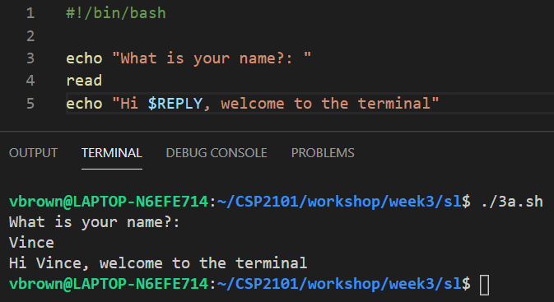
Using read for input
Whatever the user has typed in when the script hits the read line will be stored in the $REPLY variable by default which can then be used by subsequent lines of the script
Shell Script
~/CSI6203
Output in Terminal
~/CSI6203

Slide 7
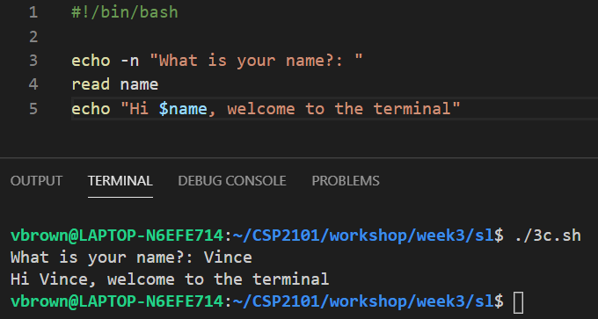
Providing read with a variable
Instead of relying on the default $REPLY variable, a custom variable can be specified instead immediately after the read command
Shell Script
~/CSI6203
Output in Terminal
~/CSI6203

Slide 8
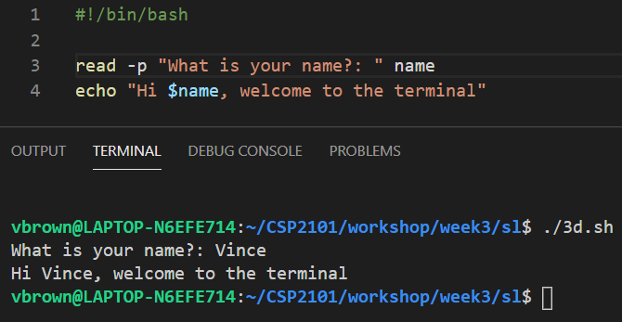
Using read –p for input
Using read with –p can allow the read command to print a prompt, removing the need for a separate echo statement
Shell Script
~/CSI6203
Output in Terminal
~/CSI6203

Slide 9
Using read –s to hide input
The input text can also be hidden for sensitive information using the –s option
#!/bin/bash
read -p "What is your name?" name echo "Hello $name"
read -s -p "What is your password?" pass echo "the secret is: $pass"
read –n1 -p "Press any key to continue"

Slide 10
Escape Sequences
Some characters are difficult to type in a script due to their use in the text editor, such as Enter, Tab, CRTL-C and Backspace
These characters can be printed using escape sequences
An example of an escape sequence is \n for Newline
Escapes can be enabled in the echo command using the -e option
Escape Sequence | Output
\b | Backspace
\c | Remove extra output (such as newlines)
\n | Newline
\r | Return to start of line (Carriage Return)
\t | Tab character
\v | Vertical Tab character
\\ | Backslash ( \ )
Common Escape Sequences

Slide 11
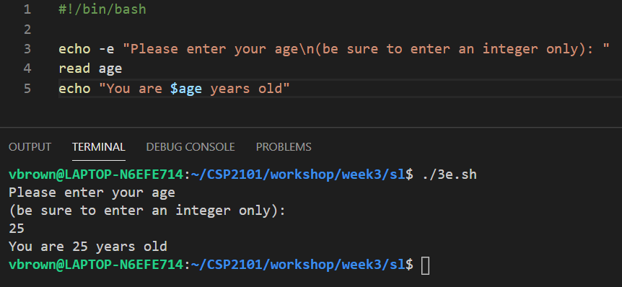
Escape Sequences
Escapes can be used to format outputs for example:
Shell Script
~/CSI6203
Output in Terminal
~/CSI6203

Slide 12
Conditional Testing

Slide 13
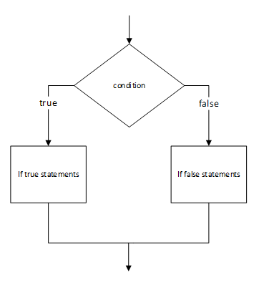
Conditional Tests in Scripts
Conditional Tests are used to provide scripts the ability to make decision based on one or more criterion
They allow you to make a script more useful in that it can execute only specific blocks of code as required instead of the whole script from beginning to end
This approach makes scripts more robust, easier to use, and more reliable
Conditional statements can be written with simple command-line lists of AND or OR commands combined together, or within the highly versatile if statement
if
else

Slide 14
Command-line Lists
Command-line lists are some of the simplest forms of decision making
They behave in a similar way to boolean operators in programming languages
In bash && acts as AND
In bash || acts as OR
&&
The && (AND) operator can be used to link multiple commands together
The second command will only execute if the first command succeeds, and the third command only of the second succeeds, and so on

Slide 15
Command-line Lists
The || (OR) operator can also be used to link multiple commands together
The second command will only execute if the first command fails, and the third will only execute if the second fails, and so on
The test command can be used to evaluate a true or false expression
The test will succeed (return an exit status of 0) if the provided expression is true
test will fail (return an exit status of 1) if the provided expression is false
||

Slide 16
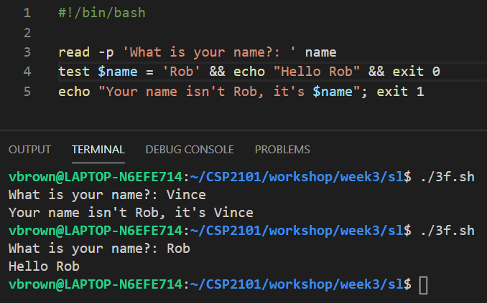
test
Command-line list expression using test:
Shell Script
~/CSI6203
test resolves to false (1)
Output in Terminal
~/CSI6203
test resolves to true (0)
~/CSI6203

Slide 17
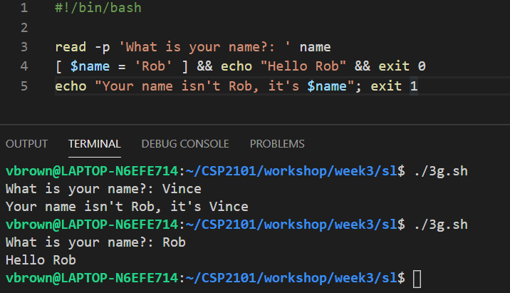
[ as test
There is also a shortcut for the test command
The [ command can be used with the same effect
Command-line list expressions using [ ]:
Even though [ is a command, a closing square bracket is still required
Shell Script
~/CSI6203
test resolves to false (1)
Output in Terminal
~/CSI6203
test resolves to true (0)
~/CSI6203

Slide 18
test booleans
AND, OR and NOT boolean expressions can be used within the test statement to allow for more complex decision making logic to be implemented within a script
-a represents AND
-o represents OR
! represents NOT

Slide 19
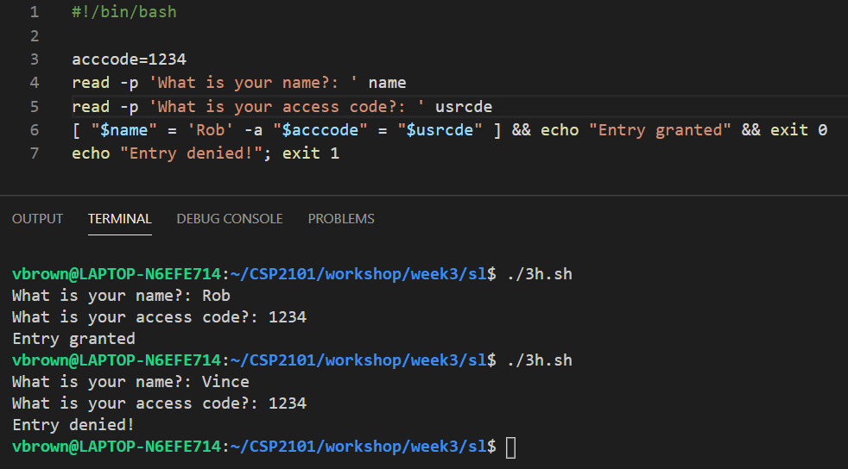
test Boolean –a (AND)
User must be Rob AND provide access code 1234
Shell Script
~/CSI6203
Output in Terminal
~/CSI6203
~/CSI6203

Slide 20
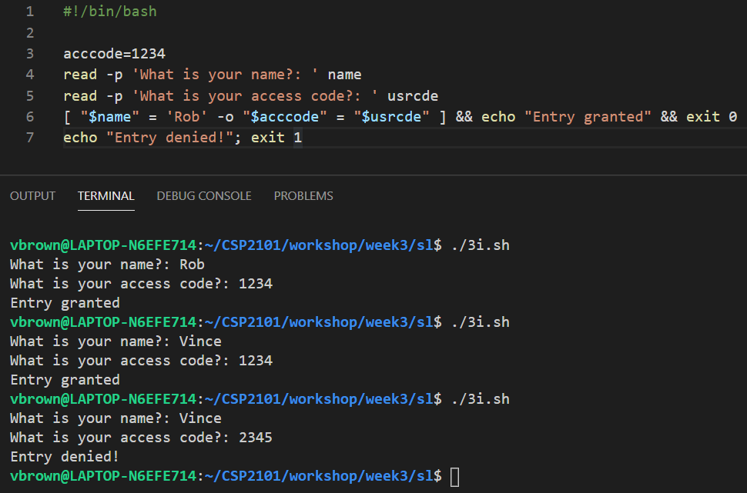
test Boolean –o (OR)
User can be Rob OR provide access code 1234 to enter
Shell Script
~/CSI6203
~/CSI6203
Output in Terminal
~/CSI6203
~/CSI6203

Slide 21
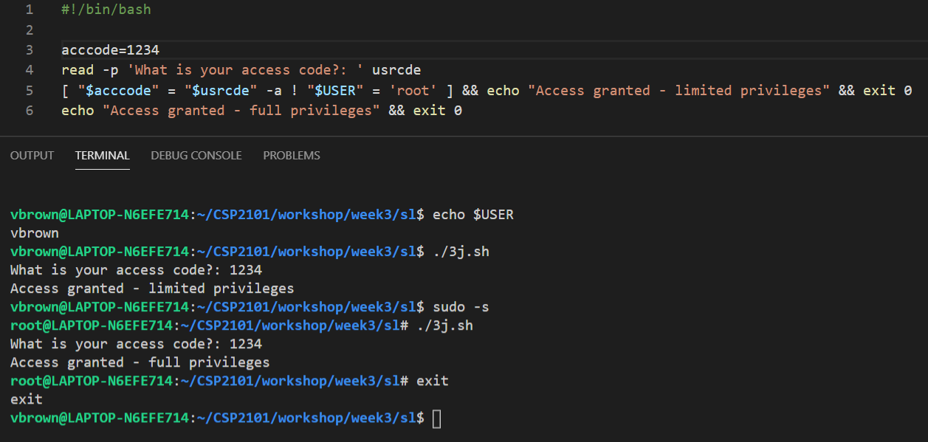
test Boolean ! (NOT)
If user provides access code 1234 and is root user – full privileges
If user provides access code 1234 and is not root user – limited privileges
Shell Script
~/CSI6203
~/CSI6203
User is not root
Output in Terminal
~/CSI6203
~/CSI6203
~/CSI6203
User is root
~/CSI6203
~/CSI6203

Slide 22
Other applications of test
test can be used to test numeric values…
Test can be used to check status of files and directories as well
Condition | Meaning
-eq | Is equal to
-gt | Is greater than
-lt | Is less than
-ge | Is greater than or equal to
-le | Is less than or equal to
Condition | Meaning
-e | File or directory exists
-d | Is a directory
-f | Is a normal file (not a directory or device file)
-s | file is not zero size
-b | file is a block device (e.g. /dev/sda1)
-r | Is readable
-w | Is writeable
-x | Is executable
-nt | Is newer than
-ot | Is older than

Slide 23
If statements
Although command-line lists are useful for short, simple logic, If statements are often more readable and a better choice when writing shell scripts
The code within the if block will only execute if the condition evaluates to true
The code within the else block will only execute if the condition evaluates to false
BASIC IF STATEMENT STRUCTURE
if [ $x –eq $y ]; then
# code to execute if true
else
# code to execute if false
fi

Slide 24
Elif
The if statements can be further extended by providing multiple branching paths with elif:
IF STATEMENT WITH ELIF FOR FURTHER BRANCHING
if [ $x –eq 1 ]; then
# code to execute if true
elif [ $x –eq 2 ]; then
# code to execute if true
else
# code to execute if false
fi

Slide 25
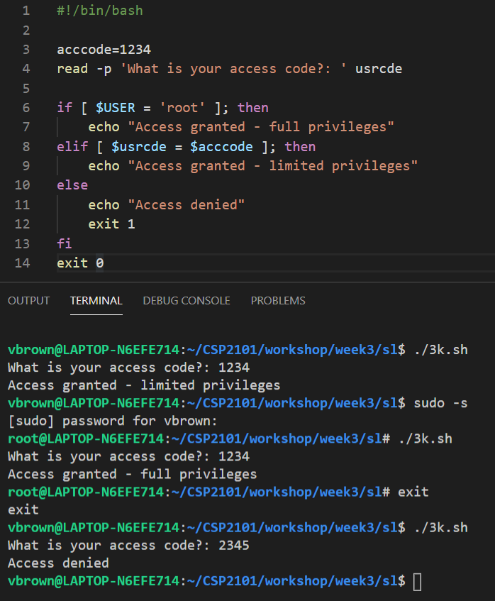
if elif else – full example
Shell Script
Output in Terminal
~/CSI6203
~/CSI6203
~/CSI6203
~/CSI6203
~/CSI6203
CODE EXPLAINED
~/CSI6203
If the user is a root user, grant full privileges and exit the if statement
If the user is not a root user but provides a valid access code, then grant them limited privileges and exit the if statement
If the user is not a root user and has not provided a valid access code, grant them no privileges and exit the if statement

Slide 26
The case statement
The case statement provides an alternative logical control structure when multilevel if-then-else-fi statements become too long and complex, in which case it easier to construct and
The case statement enables the matching of several acceptable values against a singe variable, usually contained within a variable
A general rule-of-thumb in programming is that if an if-else structure exceeds four (4) levels, use a case statement instead
BASIC CASE STATEMENT STRUCTURE
case test_value in
val-opt_1) # code if true
;;
val-opt_2) # code if true
;;
val-opt_3) # code if true
;;
*) # code if none above apply
;;
esac

Slide 27
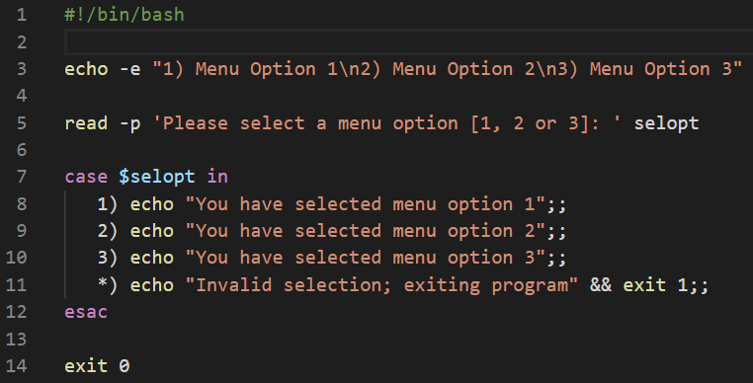
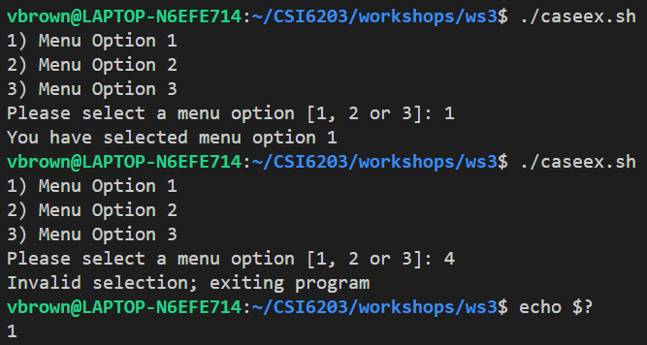
The case statement
Variable that contains value to be tested, e.g. string, integer, float etc
Each option in the case statement must end in double semi-colon
Each allowable value must be immediately followed by a close parenthesis )
* represents the default option to be executed if none of the allowable values in the list are matched; the * is optional

Slide 28
Working with Arrays

Slide 29
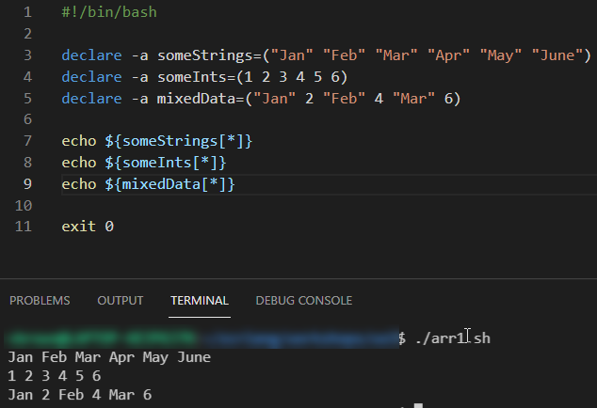
bash Arrays
An array is a collection of data elements stored in contiguous memory locations
Depending on the programming language being used, arrays can hold either heterogeneous or homogenous sets of data
Arrays are an essential programmatic structure due to their ability to store sets of related data, which is something standard variables cannot generally do
So whenever managing sets of related data, consider storing them in arrays

Slide 30
bash Arrays
Bash arrays come in two different types, these being Indexed Arrays and Associative Arrays
An Indexed Array uses ordered integers as access keys (indexes) to identify array members positionally starting from 0. An Indexed Array is much like an ordered list
An Associative Array, which is also sometimes referred to as a hash table uses keys (indexes) represented by arbitrary strings
In this unit, we are mainly concerned with the use of Indexed Arrays
Position 0
Position 1
Position 2
Position 3
Position 4
Position 5

Slide 31
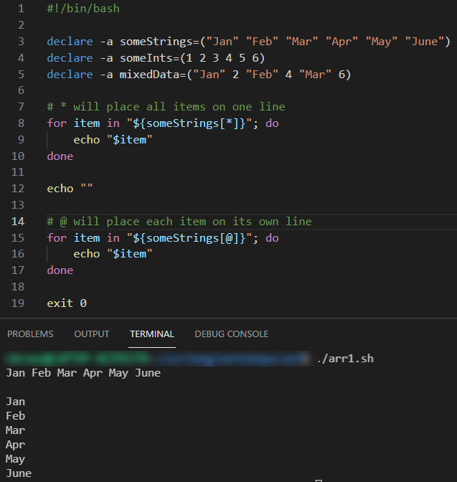
bash Arrays
There are multiple ways to access and output array data
* will output all array members on a single line in the output destination, e.g. terminal, file etc
@ will output each array member on its own line in the output destination, e.g. terminal, file etc

Slide 32
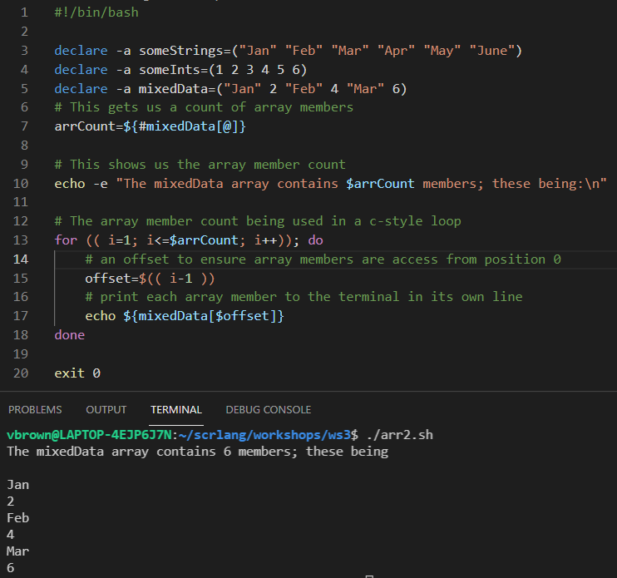
bash Arrays
Individual array members can be accessed by their index number, starting from 0 for the first member
# before the array name will get us a count of all of its members (Line 7)
A loop counter can then be based in this count when stored in a variable or produced by command substitution

Slide 33
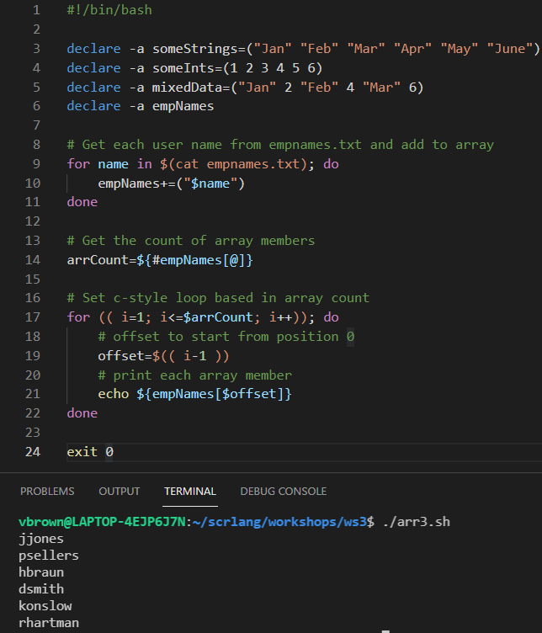
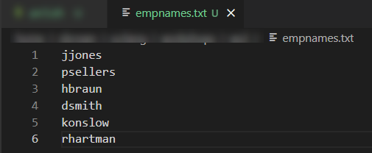
bash Arrays
Members can be added to an array when declared and initialized or afterwards when members become available
The latter can be done using the += method
You can see this in action on Line 10 inside a C-style loop structure
NOTE: We’ll be examining loop structures in detail in Module 5

Slide 34
Basic bash Maths

Slide 35
Basic bash Maths
Although shell script was not designed to handle complex mathematical equations, it does posses commands and features that allow you to perform integer and real number calculations. The bash shell supports a range of arithmetical operators with which to perform mathematical calculations. The most common of these are as follows:
Arithmetic Operator | Description
id++, id– | variable post-increment, post-decrement
++id, –id | variable pre-increment, pre-decrement
** | exponentiation
*, /, % | multiplication, division, remainder (modulo)
+, - | addition, subtraction
<=, >=, <, > | comparison
==, != | equality, inequality
&& | logical AND
|| | logical OR
=, *=, /=, %=, +=, -=, «=, »=, &=, ^=, |= | assignment

Slide 36
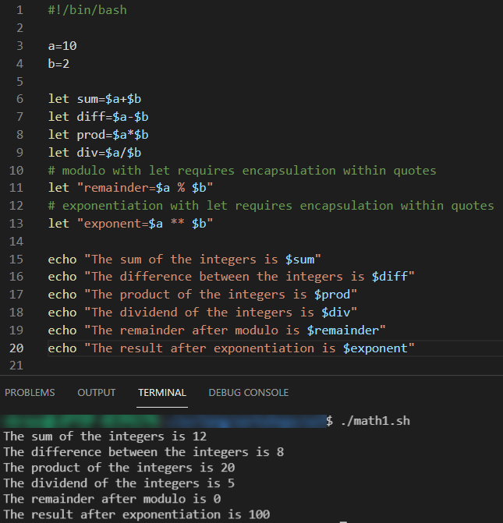
Basic bash Maths
The let keyword
Arithmetical operators can be used in conjunction with the let keyword
This approach is perhaps the simplest and most direct method by which to perform integer-based calculations, i.e., calculations that do not involve real numbers and thus must account for floating point elements
216.00256
floating point element

Slide 37
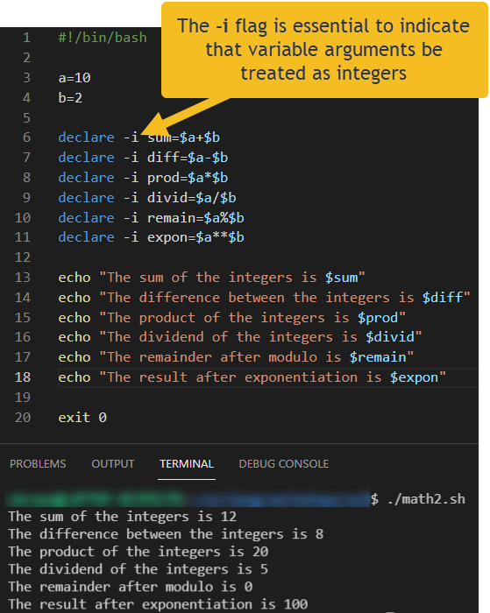
Basic bash Maths
The declare keyword
Bash does not employ strict data typing, so the declare keyword can be used to tell the system that a variable’s resident argument is to be treated as a specific data type, e.g. integer, array, etc
To this end, we can use declare to indicate that variable arguments being referred to within the context of arithmetical operation be treated as integers using the -i flag

Slide 38
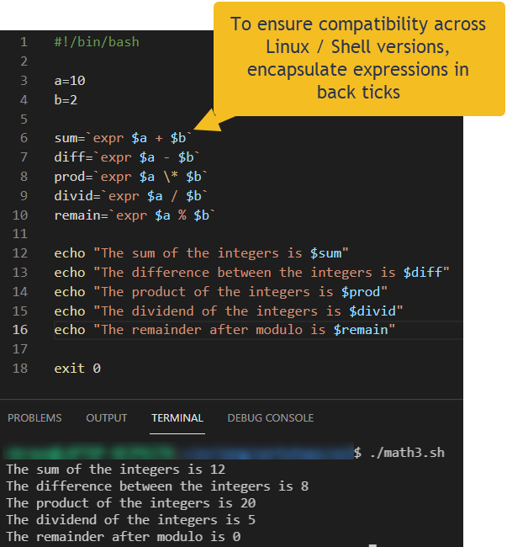
Basic bash Maths
The expr command
The expr command is extremely useful in a wide range of contexts and is also very handy for performing arithmetical operations on integers
The expr command is also great for evaluating regular expressions and performing string operations, e.g. substring, string length etc
Note – the expr command does not support exponentiation

Slide 39
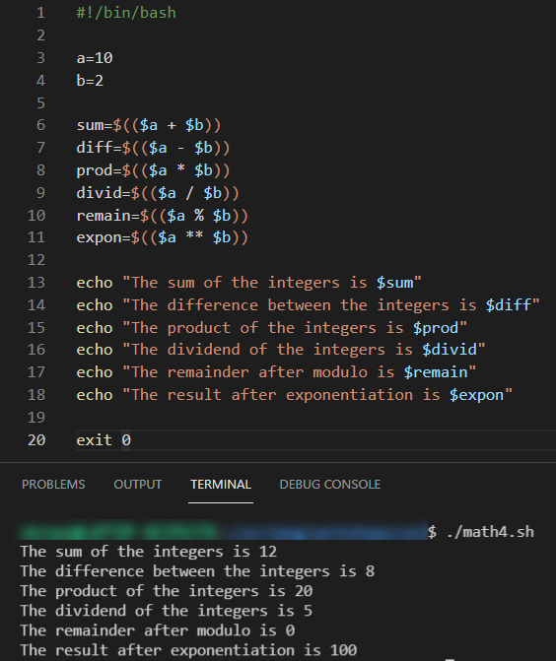
Basic bash Maths
Arithmetic Expansion
Arithmetic expansion allows the in-situ evaluation of an arithmetic expression and subsequent substitution of the result where required, e.g. assigned to a variable
It provides yet another convenient means by which to performing integer arithmetic operations in your scripts
The format for arithmetic expansion is:
$(( expression ))
Note – when using arithmetic expansion, expressions can be nested and the normal order of precedence applies

Slide 40
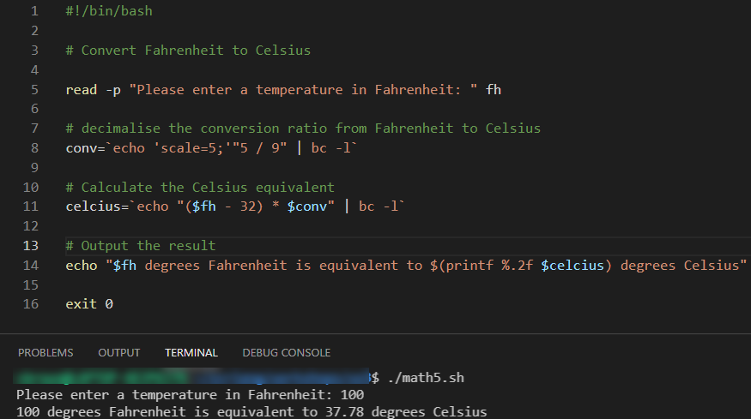
Basic bash Maths
Float Calculations Using the bash Calculator (bc)
The bc command is very useful for floating point calculations
bc stands for bash calculator
Generally, you will pass the bc a scale and an expression to be calculated
This will often be employed within a command substitution $( ) structure so a result can be stored in variable, array etc

Slide 41
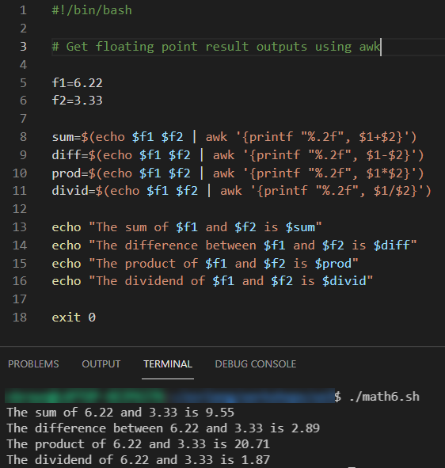
Basic bash Maths
Float Calculations Using awk
The awk utlity is also very useful for floating point calculations as it handles complex maths by design
Once again, awk can be called from within a command substitution $( ) structure so a result can be stored in variable, array etc
We’ll look at awk in more depth in Module 8

Slide 42
Code Commenting

Slide 43
Comments
Its important to comment your scripts
Comments describe the purpose of the code used to accomplish the purpose.
The purpose of a script should be understandable without ever having to look at the code and by simply reading the comments.
Commenting is best done before actually writing the code for your program.
Comments are specially marked lines of text in the program that are not evaluated.
Any statement in a script that starts with a ‘#’ symbol is ignored by the computer

Slide 44
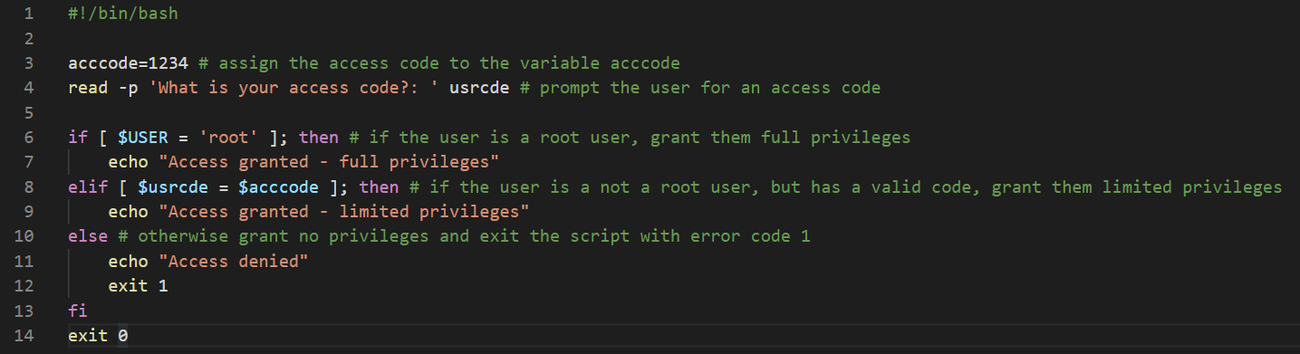
Comments
IMPORTANT NOTE
Thorough commenting will form part of your assessments so be sure to get into the habit of writing them

Slide 45
References and Resources
Ebrahim, M. and Mallet, A. (2018) Mastering Linux Based Scripting (2nd Ed). Chapter 2, pp 35-52
Free Software Foundation, Inc. (2019) GNUBash Reference Manual. Edition 5.0 for Bash Version 5.0. Available at https://www.gnu.org/software/bash/manual/bash.pdf
SS64.com. (2020) An A-Z Index of the Linux command line: bash + utilities. Available at https://ss64.com/bash/

